Slide 1
Class Navigator

Slide 2
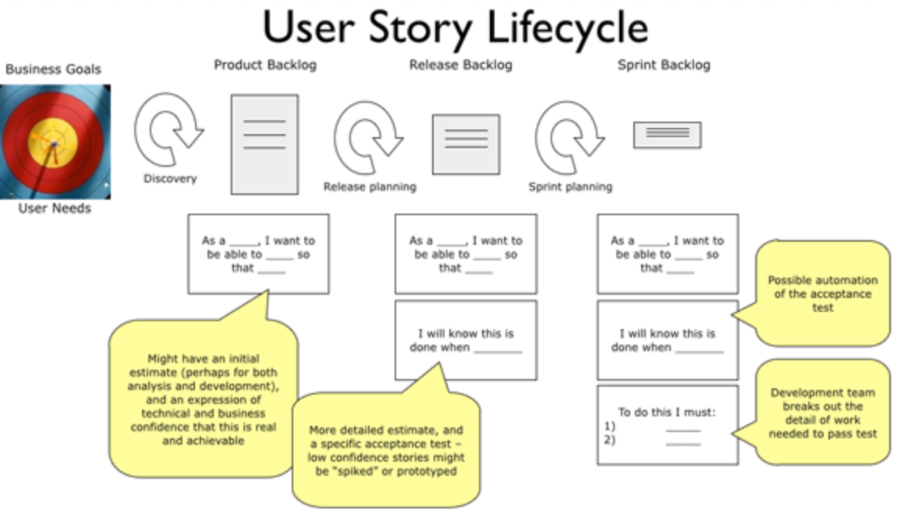

Slide 3
Business Goal:
Our goal is to build a cross platform mobile application that assists incoming college students or school faculties with indoor navigation which will provide elegant, aesthetically pleasing panoramic tour to our university

Slide 4

User story #1
User story: Product backlog: Sprint backlog:
As a user I want to be able to Sign up in your application
I know this can be done when we implement a User Registration page
Insert User details into the database
Code Registration Page for android using Java
Code Registration Page for IOS using Swift
Name: Jack
Status: Freshman student @
Pace University
Start Testing Registration Page

Slide 5
Acceptance Criteria
When I go to sign up page, the application asks me to fill in basic details like First Name , Last Name , User Name , Password , Confirm Password, Email and Phone Number.
If all details filled correctly, it redirects me to sign In/Login page again.

Slide 6

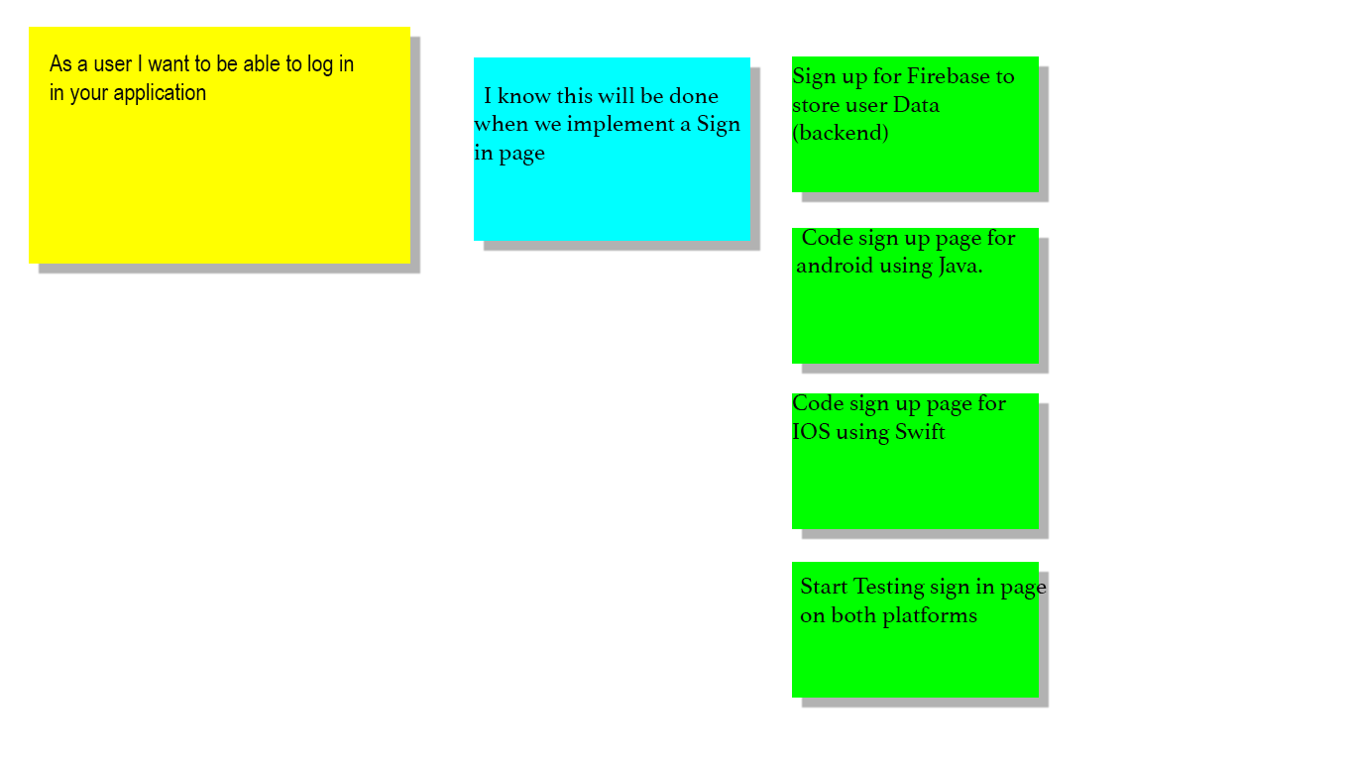
User story #2
User story: Product backlog: sprint backlog:
Name: Caroline
Status: Freshman student @
Pace University

Slide 7
Acceptance Criteria
Given I’m a logged-out system user and I’m on the Sign-In page
When I fill in the “Username” and “Password” fields with my authentication credentials
and I click the Sign-In button
Then the system signs me in

Slide 8

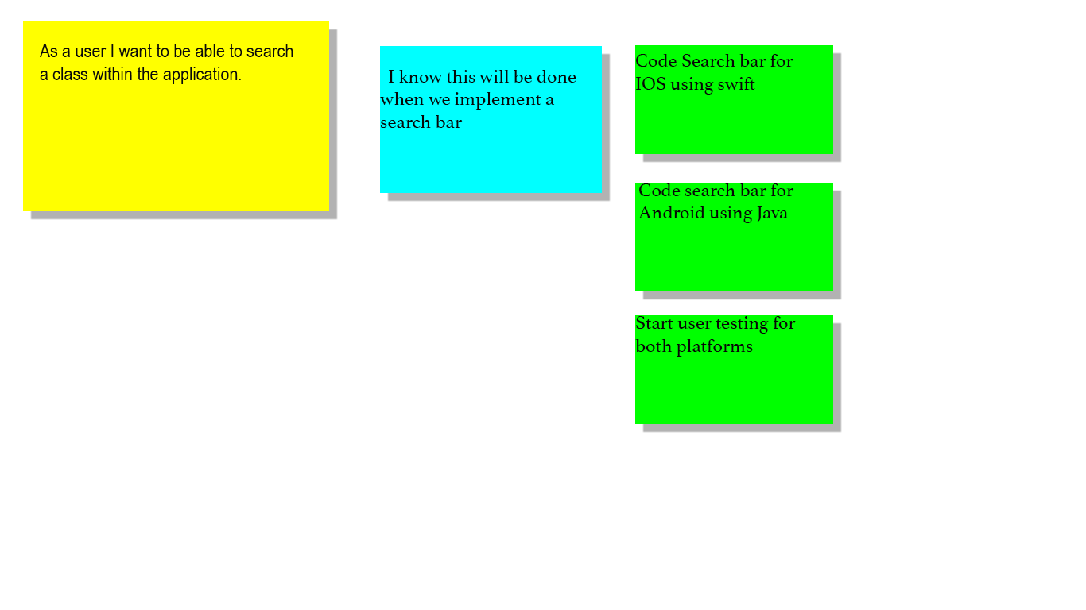
User story #3
User story: Product backlog: sprint backlog:
Name: Katy Dough
Status: Visiting Parent student @
Pace University

Slide 9
Acceptance Criteria
Given that I’m in a role of registered or guest user
When I log in to my account
Then the application shows me the “Search” section in the centre of the screen
And when I click on the “Search” section it displays list of available classes/locations.
When I fill in the “Search” field with the name of existing class/locations in the search list
And I click the “Apply” button OR press the Enter key on keyboard
Then the application opens my camera application

Slide 10

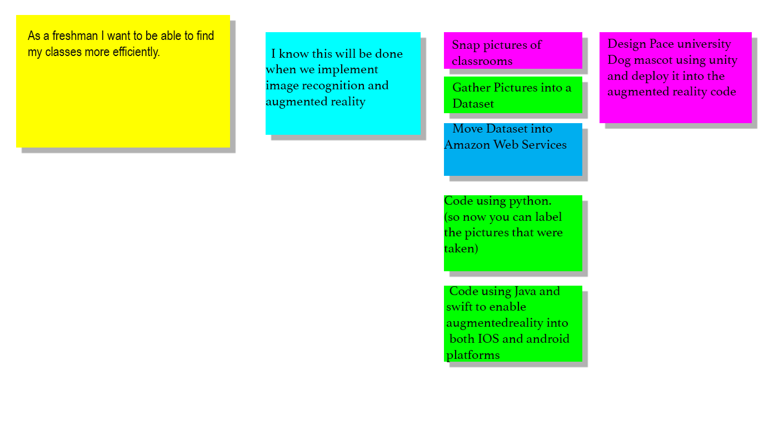
User stories #4
Name: Ashley Freeman
Status: Freshman student @
Pace University
User story: Product backlog: sprint backlog:

Slide 11
Acceptance Criteria
GIven that i have now entered the location i want to visit
My camera application opens up and a little dog appears
And that dog interacts with me and guides me to the classroom/location i searched
And when the location is reached it disappears after wishing me ”Goodbye”

Slide 12

User story #5
User story: Product backlog: Sprint backlog:
As a user I want to be able to Sign out of the application and if required sign in again
This can be achieved by redirecting to sign in page
Clearing out the user details from current session
Redirecting the user to the sign In page
Name: Janes
Status: Staff Member

Slide 13
Acceptance Criteria
Once I am done with the task of navigating to the destination
If I want to exit the application , I can go to the menu and click on logout button
Upon clicking on logout button it gets redirected to Sign In page.

Slide 14
Test Case Id | Test case Name | Test case description | Expected output
1. | User Registration/signup | New Users click on signup to be redirected to signup page | Users get redirected to signup page
2. | Creating Account | User enters account information like name, email, phone number, username and password | Signup complete
3. | Phone number | User enters numbers | Phone number accepted
4. | Phone number | User enters characters | Please enter a valid phone number
5. | Password | User enters a password less than 6 digits | Please enter a password 6 digits or greater
6. | Login | User enters correct username and password | Login successful user gets redirected to his account

Slide 15
Test Case Id | Test case Name | Test case description | Expected output
7. | Login | User enters incorrect username or password | Login failed please try again
8. | Search | User clicks on the search button to see list of available destinations | User sees lists of available destinations
9. | Selection | User selects his destination from the available list | Selection complete and Camera application opens up
10. | Log out | User selects log out | Successfully logged out redirected to login page

